Slide 1
Countering COVID 19 in the Campuses of NUoL
National University of Laos
May, 2020

Slide 2
01.
02.
Laos in a Grand
Pandemic prevention at National Level
03.
04.
Pandemic prevention at NUoL campuses
Online teaching during the outbreak

Slide 3
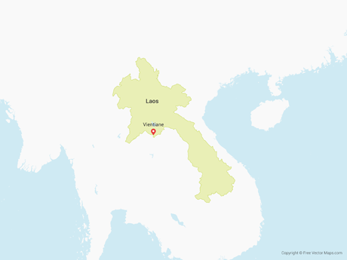
China Pop: 1,439 M Cases:82,929
Myanmar Pop:54 M Cases:182
Vietnam Pop:97 M Cases:318
1. Laos in a Grand - Surrounded by countries with high population density - First case found in 23 March - Total cases: 19 - Recovered: 14 - Active cases: 5 - Death: 0 - No new case found since 11 April
Thailand Pop:69 M Cases:3,028
Cambodia Pop:16M Cases:122

Slide 4
02. Pandemic prevention at the National Level
21st March, First action to lock down busineses in tourism, social events, public transportation
29th March, Nationwide lockdown and curfew till 14 april
Cancellations, delays and shutdowns all activities that gather numbers of people such as national sport event, education, business and production.
Set up checkpoints on road connect from district to district to monitor passenger.
Quarantine comers from different provinces and countries for at least 14 days.
Cutting off villages
Practice curfew where only one member of the family can go out to purchase essential goods.

Slide 5
02. Pandemic prevention at the National Level
13rd April, Lockdown extension till 28 April.
1st May Ease locking down by Allowing citizens to go out within their home province
15th May further easing locking down by allow citizens to travel across the country, and running their business as normal life. However,
Migration in and out the country remain prohibited.
Remain social distancing and hygiene measure
Remain closing down entertainment business

Slide 6
02. Pandemic prevention at the National Level
Pandemic control and prevention task forces
National Level who publish daily data on confirmed and suspected cases in all provinces.
Ministerial Level
Provincial level
District level
Village level

Slide 7
03. Pandemic prevention at NUoL
Under the leadership of the NUoL president, University task force was appointed.
21st march, Closing all university activities including teaching and learning activities
By taking turn, only a few staff were assigned to be on office duty for each office, the rest were encouraged to work from home.
Only one University gate opened for entrance and exist
Promote online teaching and learning

Slide 8
03. Pandemic prevention at NUoL
Measures toward students
During the Uni closed down, domestic and foreign students can choose to stay to go back to their hometown
Returning students from their provincial or country travels are quarantined in a separated zone for at least 14 days
Students who prefer to stay in the dorm are required to strictly follow the prevention measures such as no party is allowed.

Slide 9
03. Pandemic prevention at NUoL
Task Force in action:
Ad hoc team is appointed:
Doctors and nurses
Ambulance drivers
University guards
Student representatives
24 hours on duty
Patrolling campuses
Daily report for suspects or cases

Slide 10
04. Online teaching at NUoL during the outbreak
6 faculties have conducted teaching and learning via online modes during lockdown.
Economics and Bussiness Management
Social Science
Natural Science
Education
Architacture
Political Science

Slide 11
04. Online teaching at NUoL during the outbreak
Opportunities and advantages:
WhatsApp, Zoom, Google Classroom, and YouTube are commonly used.
Opportunities for Lecturers to learn ways of teaching via online.
No limited time and space for both lecturers and students.
Right time for improving teaching materials.
Teaching and learning have gone well and be able to achieve set targets and plans.
Students are highly motivated and eager to learn via online platform.

Slide 12
04. Online teaching at NUoL during the outbreak
Some key issues:
Limited knowledge on how to use online learning platform which resulted in limited knowledge transfer.
Limited/no access to Internet for remote and marginalized students.
Poor signal of Internet in some areas.
Marginalized students do not have computers, smart phones.
Communication between students and lecturers are lesser effective.
Not ideal for some science courses that need more practice.
Guideline for teaching and learning is yet in placed resulting in uncommon practice in online teaching.
Quality is not assured due to the lack of monitoring system.

Slide 13
THANKS!
Kaisone_p@nuol.edu.la
+856 20 55662299

