Slide 1
Make Campus Immune to Covid-19 and Start Academic Initiatives
Dr. Muhammad Samad Pro-Vice Chancellor and Professor University of Dhaka Bangladesh
Date: 20 May 2020

Slide 2
Content
Background
Guidance on online education service
Challenges of Online Teaching in the Universities of S&SE Asian Region
Recommendations
Conclusive remarks

Slide 3
Background
Asia region is not lagging behind in continuing education provision amidst the pandemic, so are western and eastern regions.
To regularize the educational activities in the institutions- school, college and universities, an effective and commanding administration is mandatory.
Let’s discuss some salient features to conduct successful online-based educational activities.

Slide 4
Guidance on online education service
Role of Leadership of Authoritative bodies
motivating peers rather than convincing them to conduct online class lectures
Once the faculty members are encouraged to adopt online-based teaching technics, students are ready to accept the alternative ways of learning during adverse situation

Slide 5
Guidance on online education service
Uniformed approach Decision Making
Faculty participation in interactive online meetings, proposing plans, identifying pros and cons of the planning, and agreeing to certain points to consolidate a decision.
Further meetings with deans and chairmen of different faculties for clarification.
Conveying final decision to all through emails, phone calls and short message service (SMS)

Slide 6
Guidance on online education service
Deployment of IT Team
Information Technology (IT) services to centrally monitor online education system
manual recordings, like managing a Microsoft Excel Sheet if financial and technical resources for developing accounts/portals for all individuals
Delivering information through short message services (SMS) and emails

Slide 7
Guidance on online education service
Mode of Online Class and Assessments
Zoom, Google Hangouts meets, Microsoft Teams Meeting and Skype etc. with one click on a link.
Single platform to be chosen to ensure uniformity and avoid comparison conflicts
Quiz examinations via google classroom. Presentation examinations by keeping the video mode on though, internet accessibility will be considered
Written examinations converted to assignment forms and assessed thereby.

Slide 8
Guidance on online education service
Training and Role of Faculty Members
Online training by sending YouTube video links on e-learning techniques and sample video tutorials on online classes.
Converting lectures to PowerPoint Presentation (PPT) with relevant examples, flow charts, diagram, images and graphs
Theories to teach with examples while practical classes need heuristic approach
Mathematical, engineering and business study classes to follow distinct technics understandable by the students

Slide 9
Guidance on online education service
Training and Role of Faculty Members
Using pen and paper or white boards if available, in the video sessions rather than lecturing
PPTs, lecture notes, lecture videos or audios and relevant online links should be provided to students through google classroom, google drive or drop box or combined emails or uploaded in Facebook groups
Sharing the class materials in more than one platform to ensure greater accessibility
Uploading topic based reading materials one day before a scheduled class and lecture materials just after completion of a lecture session

Slide 10
Guidance on online education service
Training and Role of Faculty Members
Online classes to be conducted as per regular schedule to avoid haphazardness.
Students to be be notified by the faculty before class
All sessions to be conducted with academic sophistication and proper use of formal approach to further avoid negative remarks or any argumentative issues

Slide 11
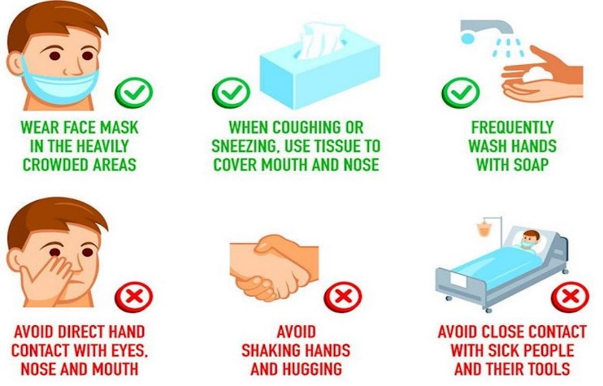
Challenges of Online Teaching in the Universities of S&SE Asian Region
Scarcity of electricity and limited internet connection
Internet packages increases monthly expenditure
when broadband internet connection or
wireless connection is unavailable.
Negative impact on mental health during the pandemic situation

Slide 12
Recommendations
Delayed class attendance or sudden absenteeism during an ongoing lecture session ought to be judged with generous consideration
Detailed report on online classes to be submitted by the faculty members to the authority when a semester ends
Requesting the Government or Internet service providers to provide internet service or data packages to all of our student with subsidized rate during this pandemic situation especially to those who are in dire need.

Slide 13
Conclusive remarks
Unless we accept challenges and act constructively, we will not be able to make a headway against presently interrupted education service.
We, as educators should come forward not to let Covid-19 engulf literacy, hence, make online education service gain ground for the time being.
Thank you for your attention!
Any questions?

